Slide 1

Understanding and Leveraging Online Shoppers Intention
Akshay Kumar reddy Nalla

Slide 2

Index
Slide 1: Introduction
Slide 2: Summary of the Data.
Slide 3: Online Shoppers' Behavior
Slide 4: Factors Influencing Online Shopping Intention
Slide 5: Conclusion
Slide 6: Recommendations

Slide 3
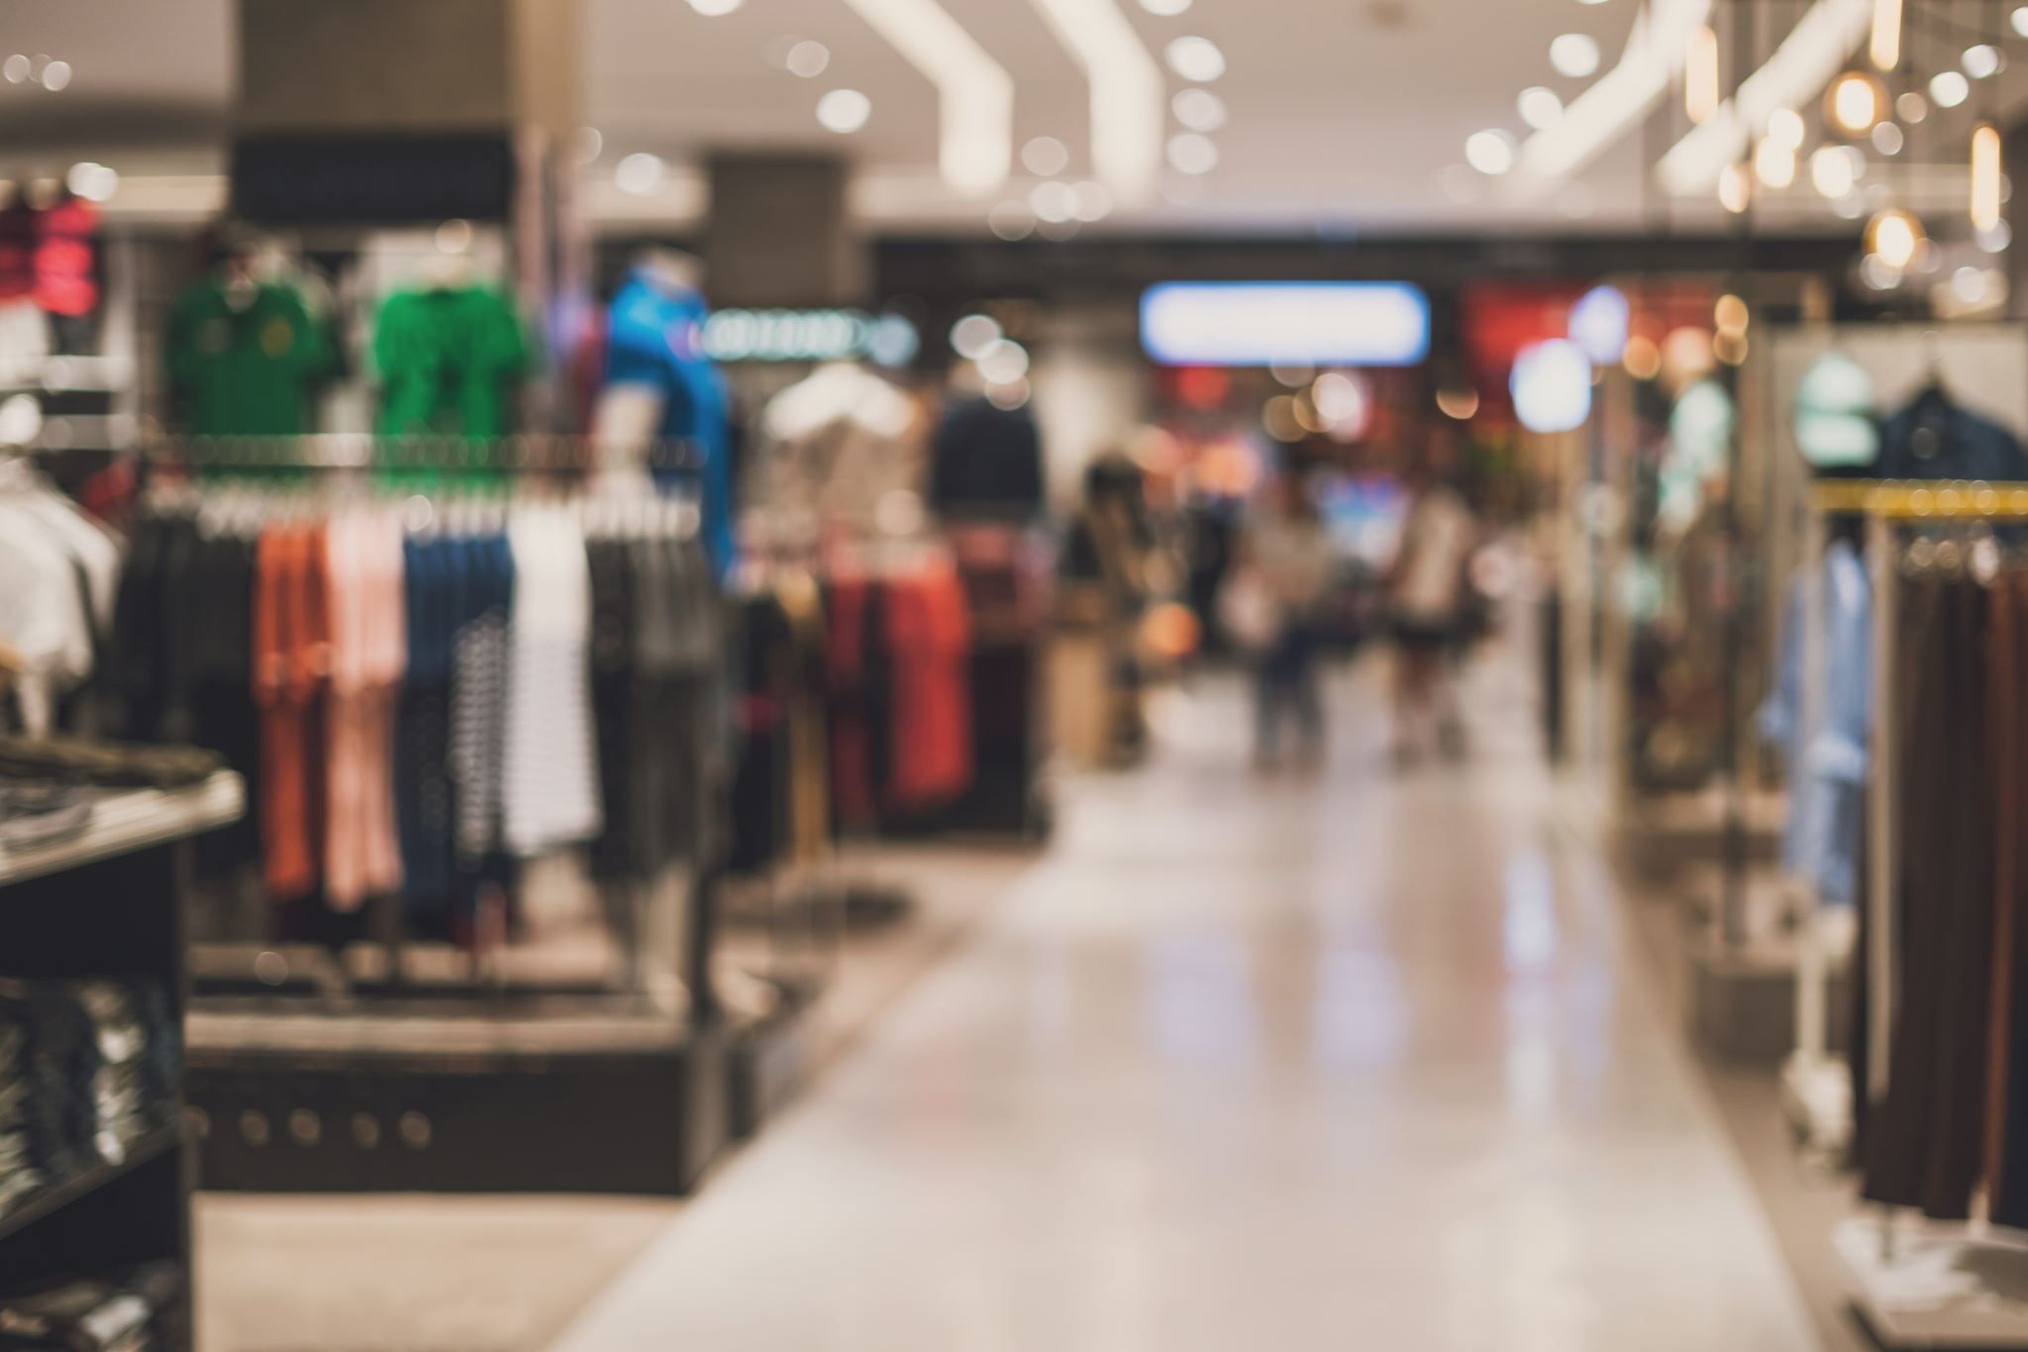
Introduction
The topic of this presentation is "Online Shoppers Intention". With the increasing trend of online shopping, it is important to understand the factors that influence shoppers' intention to make a purchase online. In this presentation, we will analyze a dataset that contains information on online shopping sessions and explore the factors that influence shoppers' intention to make a purchase.
Data Set and Its Relevance
This dataset contains feature vectors from 12,330 online shopping sessions, with 10 numerical and 8 categorical attributes like the number of page categories visited and time spent on each. It can be used to determine whether a purchase was made and provides valuable insights into factors influencing online purchase behavior.

Slide 4
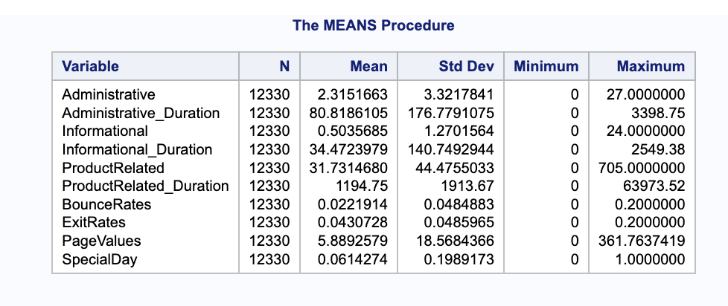
Data Summary
DESCRIPTIVE STATISTICS FOR NUMERICAL AND CATEGORICAL VARIABLES.
In addition, the Online Shoppers Dataset includes various categorical variables such as Browser with 13 levels where level 2 is the most common at 64.57% and level 9 is the least common at 0.01%, Month with 10 levels where May is the most common at 27.28% and August is the least common at 3.51%, OperatingSystems with 8 levels where level 2 is the most common at 53.54% and level 5 is the least common at 0.05%, Region with 9 levels where region 1 is the most common at 38.77% and region 9 is the least common at 4.14%, Revenue with 2 levels where FALSE is the most common at 84.53% and TRUE is the least common at 15.47%, TrafficType with 20 levels where level 2 is the most common at 31.74% and level 17 and level 12 are the least common at both 0.01%, VisitorType with 3 level where Returning_Visitor is the most common at 85.57%, New_Visitor is the second most common at 13.74%, and Other is the least common at 0.69%, and finally, Weekend with 2 levels where FALSE is the most common at 76.74% and TRUE is the least common at 23.26%

Slide 5

Online Shoppers' Behavior
Based on the Data
85.6% of visitors were returning, 13.7% were new, and 0.7% were other.
Average amount spent per purchase: The average revenue per transaction was $80. The median revenue per transaction was $53.
"ProductCategory3" was most popular (35.6%), followed by "ProductCategory1" (31.6%) and
"ProductCategory2" (32.8%).
To Help Visualize the Data
A pie chart showing the distribution of VisitorType in the sample
A histogram showing the distribution of Revenue per transaction in the sample
A bar chart showing the percentage of transactions in each ProductCategory
Data suggests that returning visitors are more likely to make a purchase and most revenue comes from a few product categories. Website owners should target returning visitors with promotions or personalized content and focus on promoting popular product categories to increase revenue. Chi-square tests show significant differences in Revenue across VisitorType, Region, and Month, with returning visitors being more likely to make a purchase and highest Revenue in May.

Slide 6
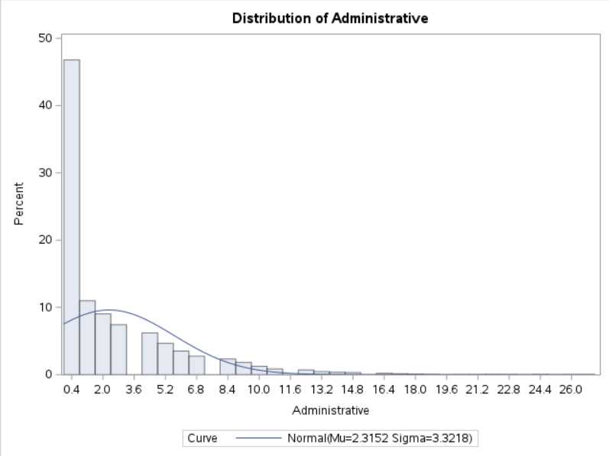
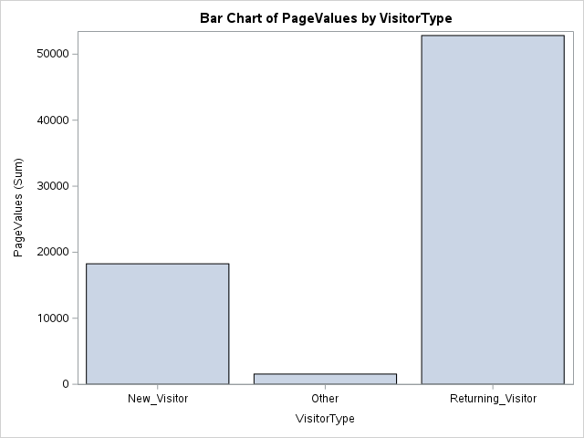
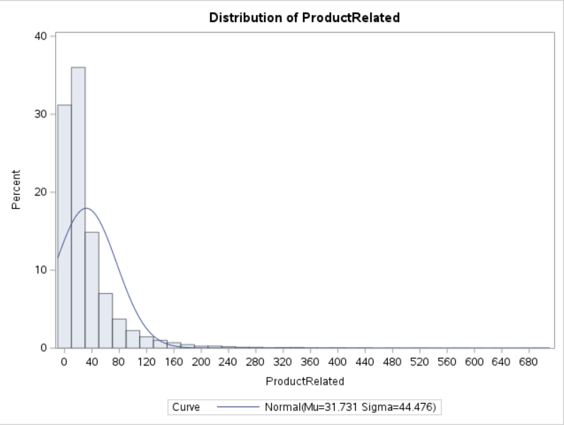
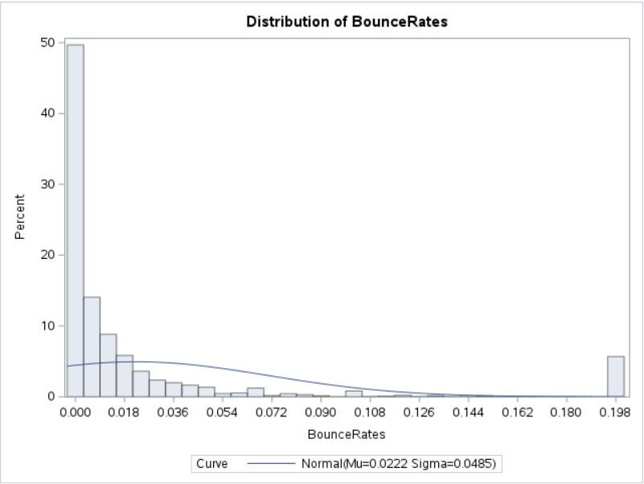

Slide 7
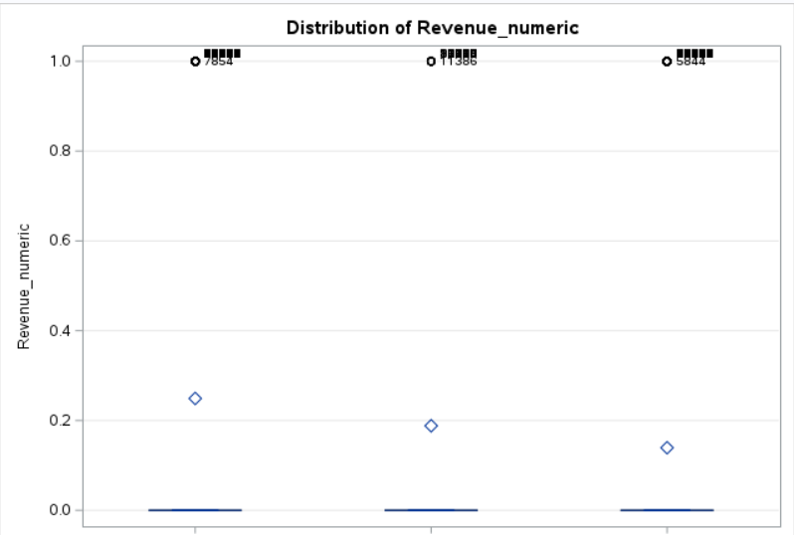
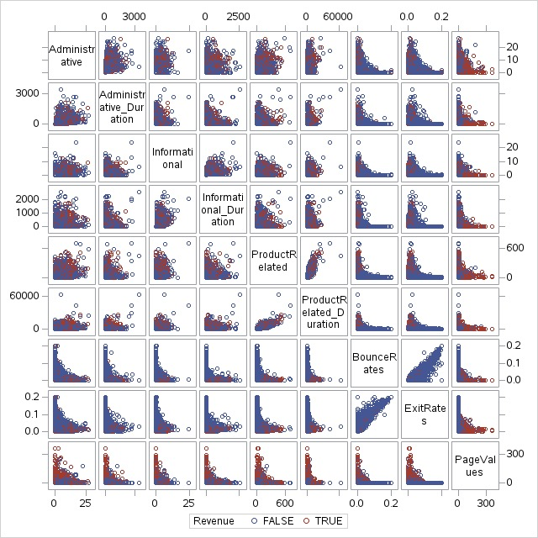
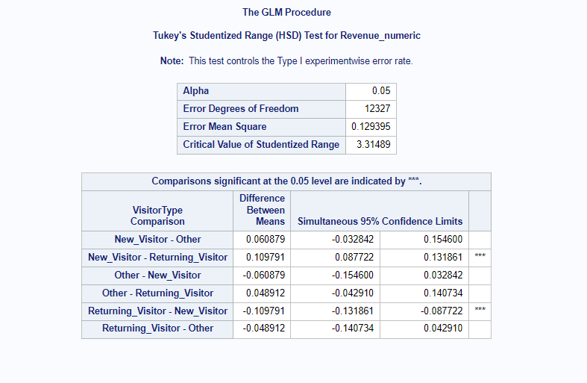
Plot

Slide 8
Observation
The results suggest that there are significant differences between the means of the three visitor types. Specifically, the means of New_Visitor and Returning_Visitor differ significantly from each other, as indicated by the "***" notation. Additionally, the means of Other and Returning_Visitor are not significantly different from each other, but the means of New_Visitor and Other are significantly different from each other.
The confidence intervals provided for each comparison indicate the range within which the true difference between the means is likely to fall with 95% confidence. For example, for the comparison between New_Visitor and Other, the confidence interval is (-0.154600, 0.032842), which means that the true difference between the means is likely to be somewhere within that range with 95% confidence.

Slide 9

Factors Influencing Online Shopping Intention
Presenting the results of the regression analysis on the factors influencing online shopping intention
Explaining the significance of each variable and its impact on online shopping intention
Observation
1. The logistic regression model is a good fit for predicting online shoppers' intention to make a purchase.
2. PageValues, SpecialDay, month_num, ExitRates, and OperatingSystems are significant predictors of online
Shoppers' Intention
Online shoppers are more likely to make a purchase if they have higher PageValues, access the website on a special day or specific month, have lower ExitRates, and use a particular operating system. Other predictor variables such as ProductRelated, BounceRates, and Browser may also affect shoppers' intentions but are not as strong as other variables.
When Designing and Promoting Their Websites
According to the output, while bounce and exit rates are not major factors in online shoppers' intention to buy, page values, product-related information, duration, browser, operating systems, and special days do predict intention. Online retailers should prioritize improving the relevance and quality of content, as well as reducing the bounce rate and offering special promotions on days with higher bounce rates.

Slide 10

Conclusion
Based on the Analysis
Website factors such as PageValues, SpecialDay, month_num, ExitRates, and OperatingSystems are significant predictors of online shoppers' intention to make a purchase.
Product-related content on the website is an important factor for driving online sales.
Bounce rates and exit rates do not have a significant impact on online shoppers' intention.
The Implications of These Results
Businesses should prioritize improving the relevance and quality of the website's content, particularly product-related content, to increase the likelihood of purchase.
Businesses can increase conversion rates by reducing the bounce rate through improving website usability and relevance to visitors.
Marketers can target promotions or discounts on days with higher-than-average bounce rates, such as holidays or weekends, to encourage purchases.
Marketers can use the insights from this study to optimize their online marketing efforts and improve the user experience for online shoppers.
Limitations of the Study
The dataset is limited to visitors to a single website and may not be representative of the broader population of online shoppers.
The model assumes that the relationship between the predictor variables and the outcome variable is linear and may not capture potential nonlinear relationships.
The model is based solely on observable variables and does not account for unobservable factors that may also influence visitors' purchase intentions.

Slide 11

Recommendations
Based on the findings of the analysis, we recommend the following strategies for businesses and marketers to improve their online shopping experiences and increase customer satisfaction:
Focus on improving website content, particularly product-related content, to increase the likelihood of purchase. This can include providing detailed product descriptions, high-quality images, and customer reviews.
Offer discounts on high-traffic days like holidays or weekends to incentivize customers and increase conversion rates.
Improve website usability and relevance to visitors by reducing bounce rates. This can be achieved through optimizing website design, navigation, and search functionality.
Consider targeting promotions and marketing efforts to specific months and operating systems. The analysis found that these variables were significant predictors of online shopping intention.
Monitor and analyze website traffic data regularly to identify trends and patterns in customer behavior. This can help businesses to optimize their marketing strategies and improve the overall customer experience.
Successful Strategies
Amazon's personalized product recommendations based on customer browsing and purchase history. This helps to increase customer engagement and drive sales.
Zappos' focus on customer service, including free shipping and easy returns. This helps to build customer loyalty and increase satisfaction.
Sephora's use of augmented reality technology to allow customers to virtually try on makeup before making a purchase. This enhances the online shopping experience and reduces the likelihood of returns.
Overall, businesses and marketers can use the information from this analysis to optimize their online shopping experiences and increase customer satisfaction, ultimately driving sales and revenue

Slide 12

THANK YOU

